Slide 1
Analysis of FDA Data Using Power BI and MySQL
`

Slide 2
Importing data for the project
Used MySQL scripts to create FDA database.
Created tables for the database.
Inserted data into these tables.

Slide 3
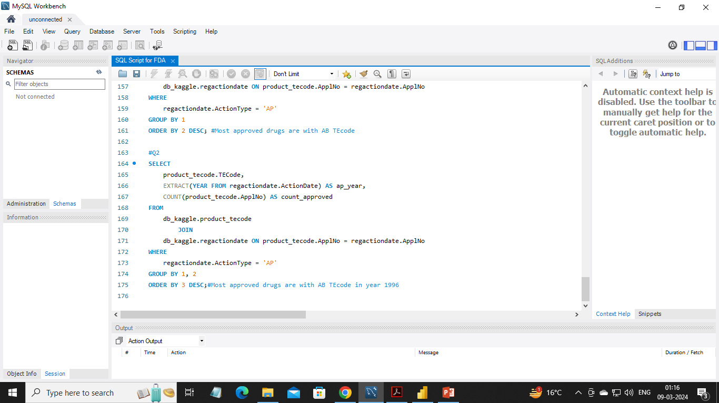
SQL Scripts
Most drugs approved after 1975
2002,2000,2001 have highest approved drugs
1945, 1943, 1944 have Lowest approved drugs
Most drug marketed under 1 status
Most drug marketed under 1 status in year 2002
Most drugs are Form of tabletOral
Most approved drugs are with AB TEcode in year 1996

Slide 4
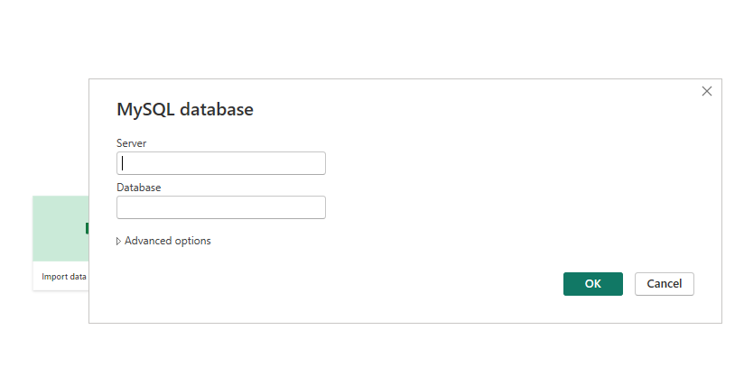
Imported data using MySQL connecter:

Slide 5
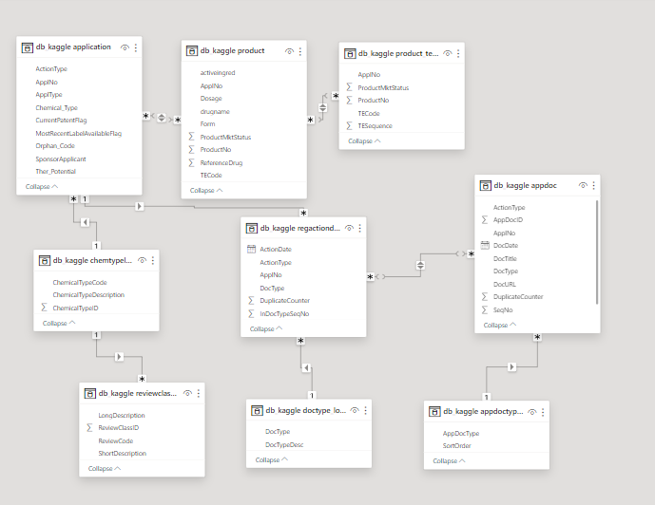
Created data model in Power BI:

Slide 6
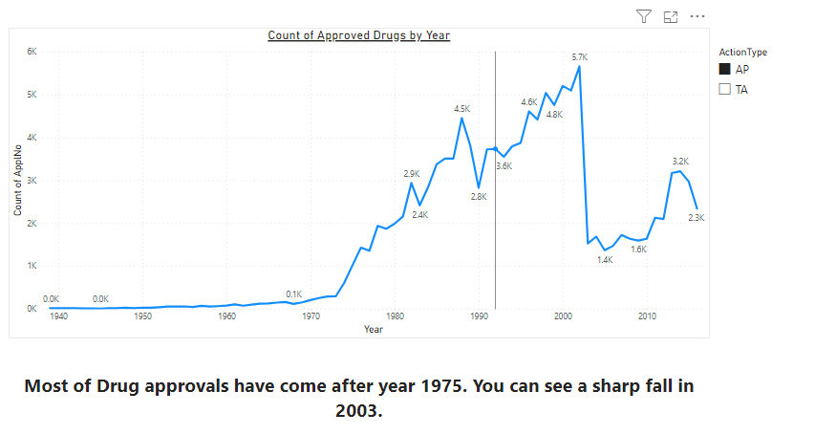
Created reports using Power BI:

Slide 7
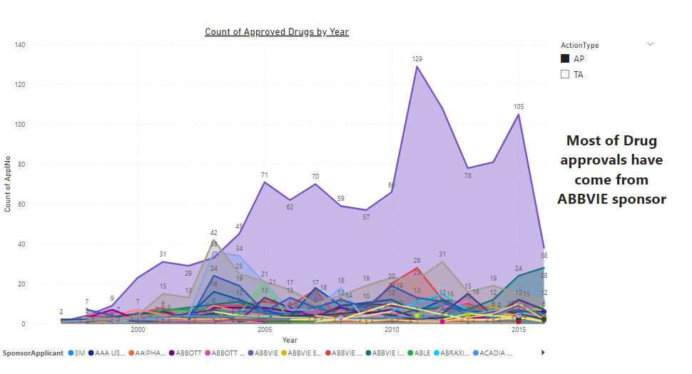
Created reports using Power BI:

Slide 8
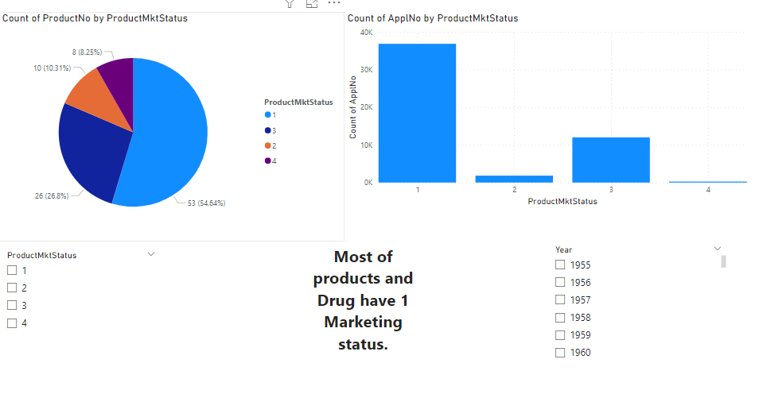
Created reports using Power BI:

Slide 9
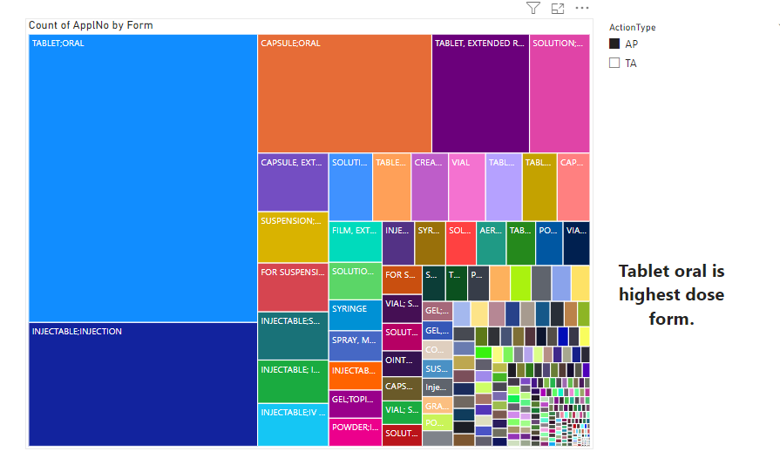
Created reports using Power BI:

Slide 10
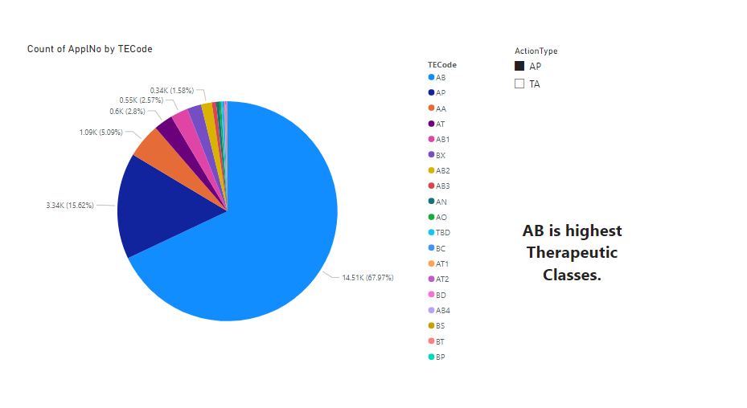
Created reports using Power BI:

Slide 11
Conclusions:
Most of Drug approvals have come after year 1995.
Most of Drug approvals have come from ABBVIE sponsor.
Most of products and Drug have 1 Marketing status.
Tablet oral is highest dose form.
AB is highest Therapeutic Classes.

Slide 12
Please ask any Questions?

Slide 13
Thank You!!

